Slide 1
Additional notes on Jairo Giraldo, et al. Adversarial Classification Under Differential Privacy, NDSS 2020
Z. Gu 2020

Slide 2
Jairo Giraldo et al. Adversarial Classification Under Differential Privacy
Abstract: The last decade has seen a growing interest in adversarial classification, where an attacker tries to mislead a classifier meant to detect anomalies. We study this problem in a setting where anomaly detection is being used in conjunction with differential privacy to protect personal information. We show that a strategic attacker can leverage the additional noise (introduced to ensure differential privacy) to mislead the classifier beyond what the attacker could do otherwise; we also propose countermeasures against such attacks. We then evaluate the impact of our attacks and defenses in road traffic congestion and smart metering examples.
The adversary model in this paper does not seek to violate privacy; rather, the adversary exploits privacy mechanisms that are implemented in a system and weaponizes them to degrade the utility of the system, while at the same time trying to evade the anomaly detection algorithm that looks for maliciously injected data.

Slide 3
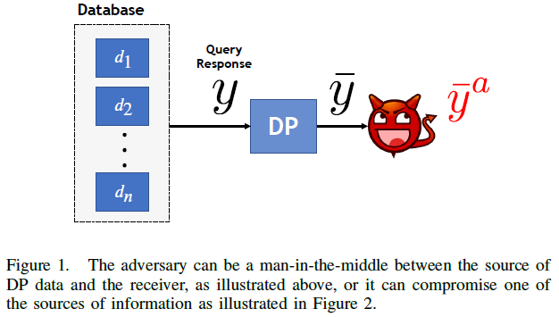
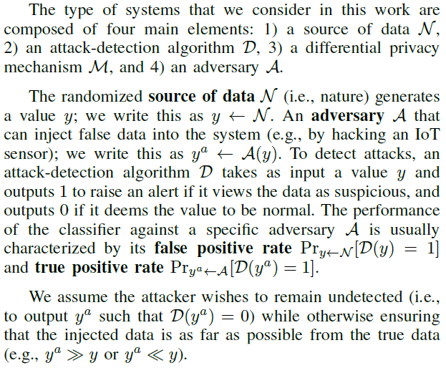
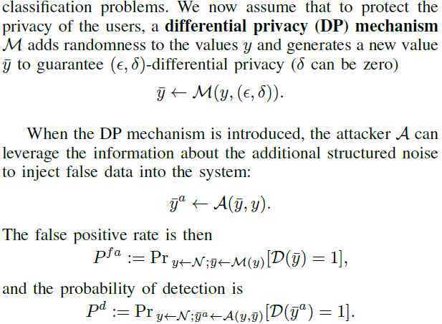
Attack Model 1

Slide 4
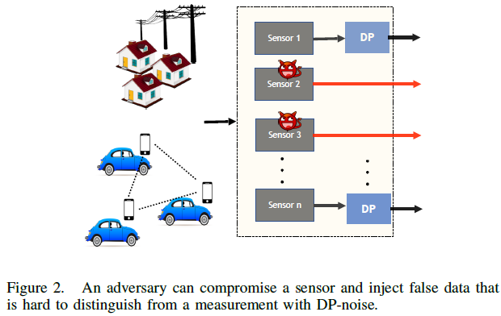
Attack Model 2: Attack on Sensors
The adversary model for local DP considers an attacker that has compromised a subset of the information sources (e.g., sensors) as illustrated in Figure 2. In this case the attacker has either compromised a subset of the sensors delivering the data, or in the case of crowdsourced data, the attacker could own a subset of the devices sending false data [8].

Slide 5
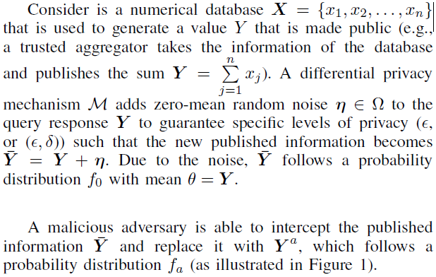
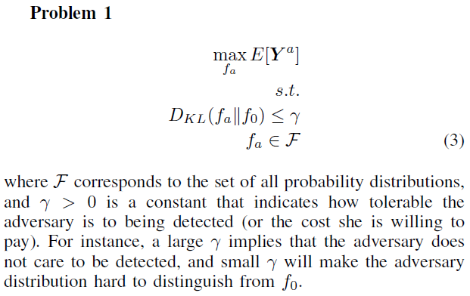
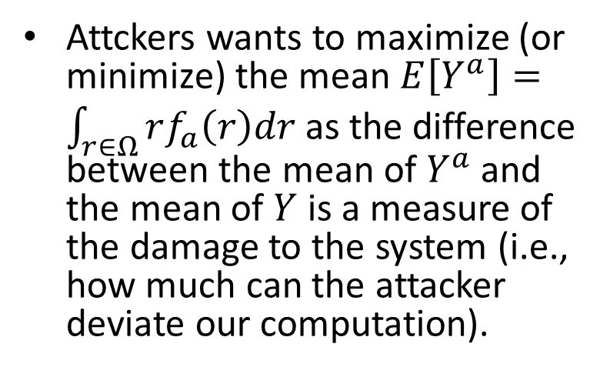
Attack Model 1: Formal Description
Attckers wants to maximize (or minimize) the mean $E\left[Y^{a}\right]=\int_{r∈Ω}{rf_{a}\left(r\right)dr}$ as the difference between the mean of $Y^{a}$ and the mean of $Y$ is a measure of the damage to the system (i.e., how much can the attacker deviate our computation).
Notes:
XXX But $E\left[Y^{a}\right]$ is not the mean of difference. But it is a stationary (min or max) point, so no matter what Y is, the stationary point of a convex function will maximize the difference.

Slide 6
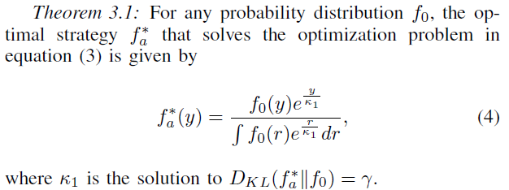

Slide 7
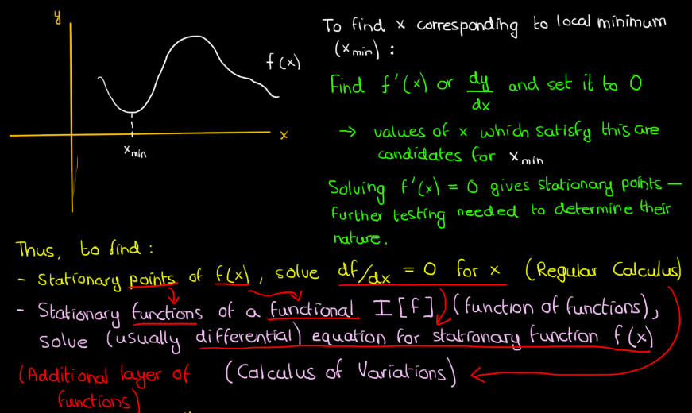
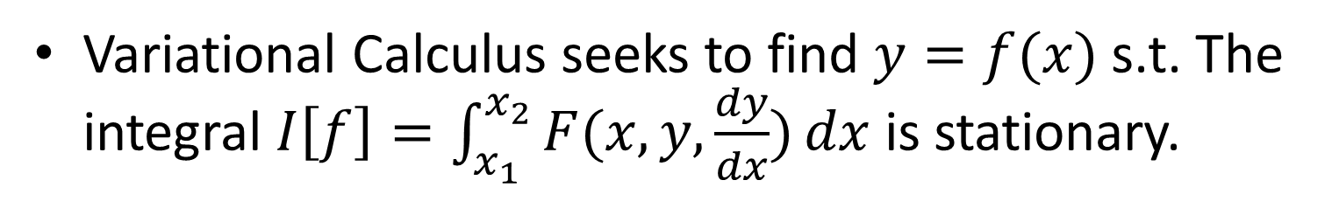
Variational Calculus
Variational Calculus seeks to find $y=f(x)$ s.t. The integral $I\left[f\right]=\int_{x_{1}}^{x_{2}}{F(x,y,\frac{dy}{dx})}dx$ is stationary.

Slide 8
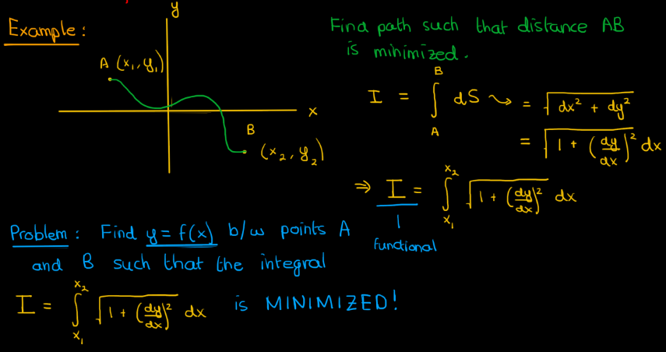
Example 1

Slide 9
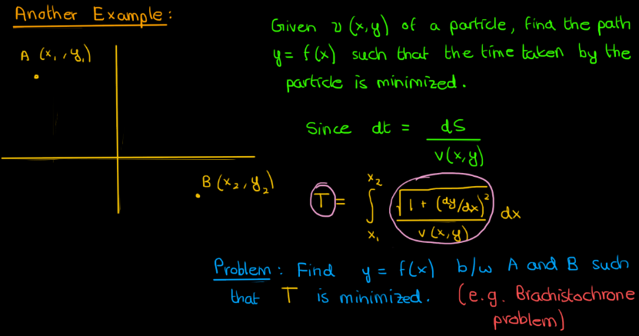
Example 2

Slide 10
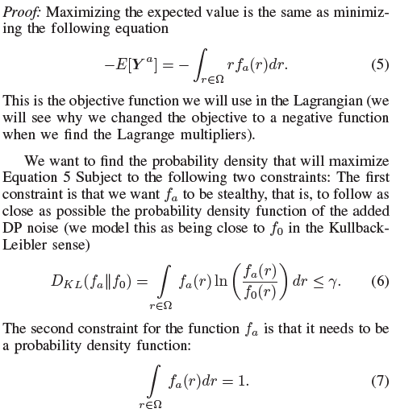
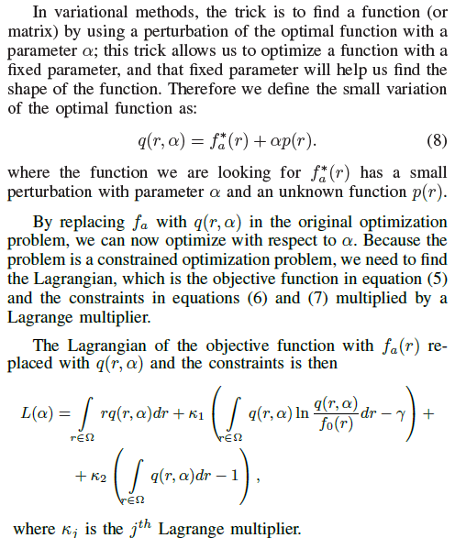

Slide 11
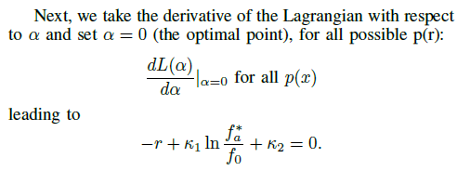
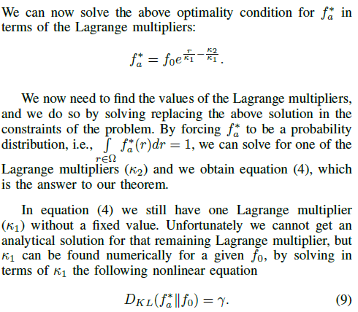
Notes:
XXX How to take the derivative of the Lagrangian?

Slide 12
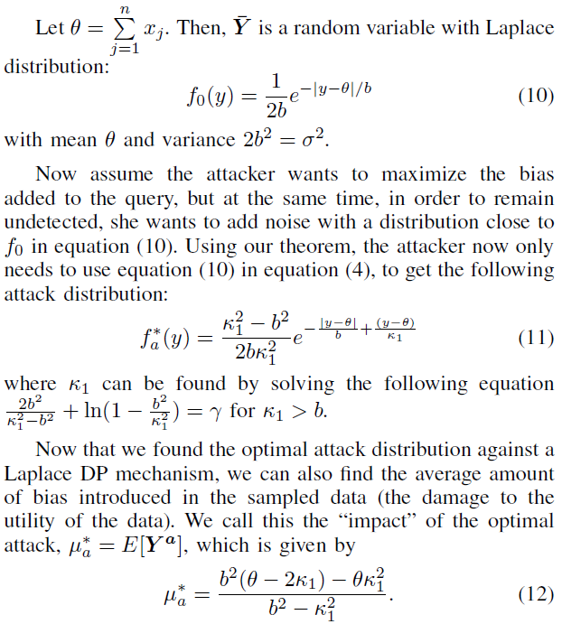
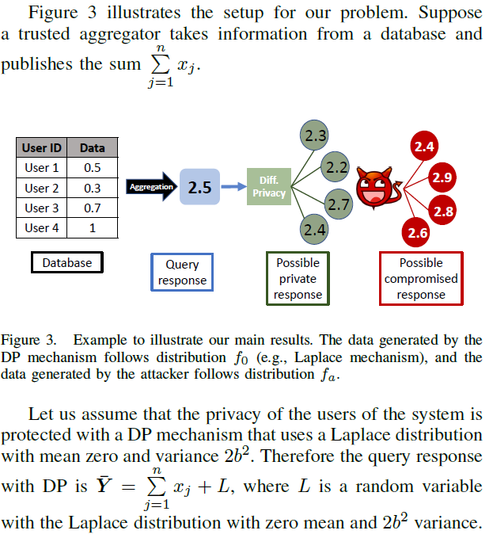
Example: DP with Laplace Mechanism

Slide 13
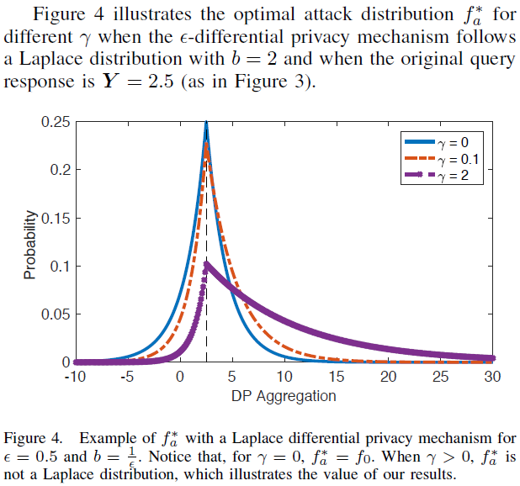

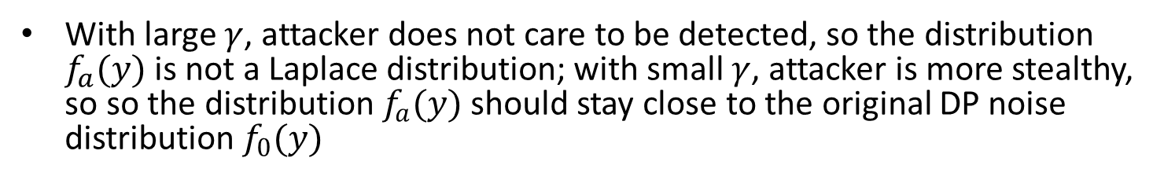
Effect of $γ$
With large $γ$, attacker does not care to be detected, so the distribution $f_{a}(y)$ is not a Laplace distribution; with small $γ$, attacker is more stealthy, so so the distribution $f_{a}(y)$ should stay close to the original DP noise distribution $f_{0}(y)$
Notes:
the $f_{a}(y)$ is closer to the Laplace distribution inserted by the DP mechanism.

Slide 14
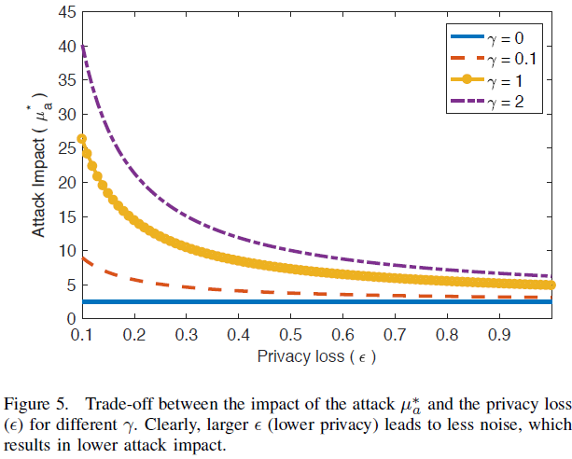
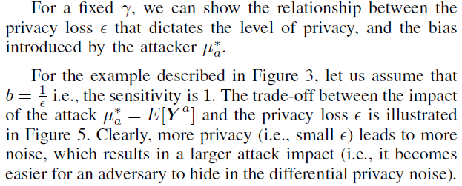
Trade-off between Impact of the Attack and Privacy

